Slide 1
DECODING DEATH
Predicting Death By US State

Slide 2
Project Participants
01
02
03
04
IAN LEE
NAVDEEP KAUR
PAUL KU
JEFF MORGAN
05
BYRON DE LEON

Slide 3



About
Notes:
For Project 4, our team worked with python, numpy machine learning (ML) and tableau Public , along with other technologies that we've learned to solve, analyze, and visualize a project decoding using opensource information to discover a problem worth solving, analyzing, or visualizing.

Slide 4
Introduction
Our group project attempts to analyze provisional counts of deaths by state and select causes for the years 2020-2023. The ultimate goal was to predict the most likely causes of death in each state for 2024.

Slide 5

Data Source
Weekly Provisional Counts of Deaths by State and Select Causes, 2020-2023
https://data.cdc.gov/NCHS/Weekly-Provisional-Counts-of-Deaths-by-State-and-S/muzy-jte6/about_data
Notes:
I’ll trun it over to Byron to dig a bit deeper into discerptions of what exactly are the causes of death facing the US

Slide 6
Causes of Death
01
02
03
04
05
Heart Disease
Malignant Neoplasm
Coronavirus (COVID-19)
Range of conditions that affect the heart
Cancers
Infectious disease caused by the SARS-CoV-2 virus
Respiratory Disease
Cerebrovascular Disease
Asthma, Chronic Obstructive Pulmonary Disease (COPD)
Group of conditions that affect the blood vessels and blood flow in the brain and spinal cord.

Slide 7
Causes of Death
06
07
08
09
10
Alzheimer Disease
Diabetes mellitus
Nephritis
Degenerative Disease of the Nervous System
A metabolic disease, involving inappropriately elevated blood glucose levels
An Inflammatory Kidney Disease
Influenza/Pneumonia
Not Elsewhere Classified
Flu-Common Cause of Pneumonia

Slide 8
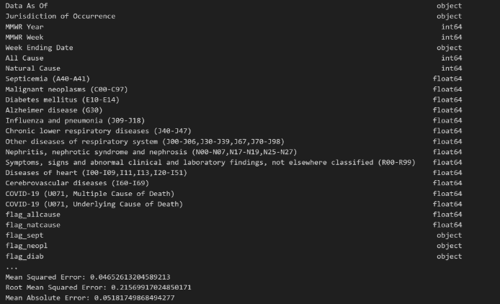
METHODOLOGY
Our Group stared by working with a Python script using pandas for data manipulation and scikit-learn for machine learning tasks, particularly regression analysis.

Slide 9

Breakdown of Data Processing
Do you know what helps you make your point clear? Lists like this one:
Converting the "Week Ending Date" column to datetime format.
Created new columns for year, month, and day extracted from the "Week Ending Date".
Aggregated the data by year, month, and jurisdiction of occurrence, summing up the "All Cause" column.
Handling Missing Values: You've printed the count of missing values in the aggregated dataset.
One-hot encoding was performed on the "Jurisdiction of Occurrence" column to encode the categorical variables.
Scikit-learn was used to standardize the numerical feature
The dataset was split the into training and testing sets.

Slide 10
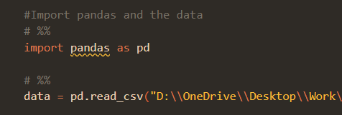
Dependencies
Python Libraries: pandas, numpy, scikit-learn
Make sure to install these dependencies using the following command
pip install pandas numpy matplotlib scikit-learn

Slide 11
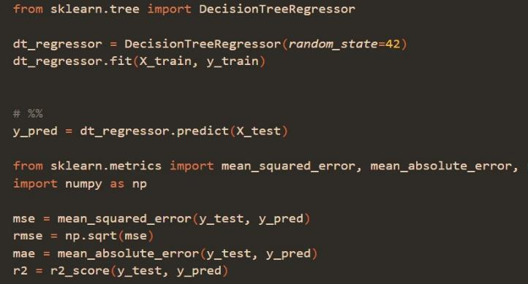
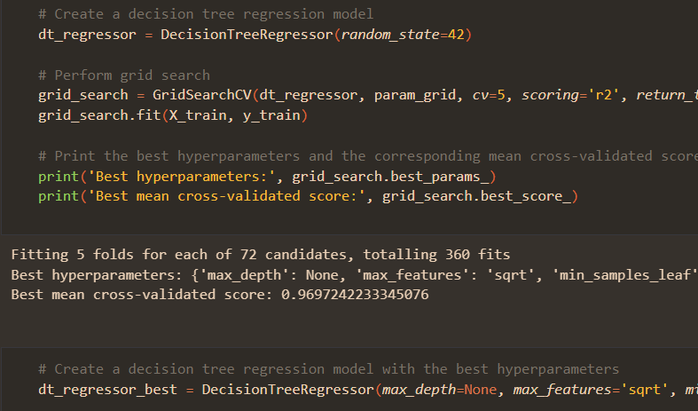
Modeling & Training
Modeling
(DecisionTreeRegressor) - "a non-parametric supervised learning algorithm, which is utilized for both classification and regression tasks." - basically, we chose not to assume the shape of the data but had labeled data.
Final Training
(GridSearchCV) - Finds the best hyperparameters for the decision tree regressor model.
Trained final decision tree model for best performance
Notes:
We trained a decision tree regression model (DecisionTreeRegressor) on the training data and evaluated its performance on the testing data using metrics such as Mean Squared Error (MSE), Root Mean Squared Error (RMSE), Mean Absolute Error (MAE), and R-squared. Later, we performed hyperparameter tuning using grid search (GridSearchCV) to find the best hyperparameters for the decision tree regressor model.
Finally, we trained another decision tree regression model with the best hyperparameters found from grid search and evaluated its performance on the testing data.

Slide 12
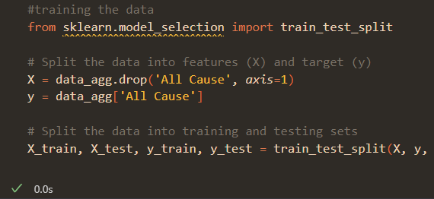

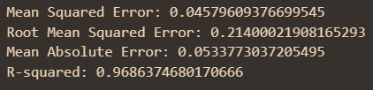
Explaining the Results
MSE, RMSE, MAE
Mean Squared Error: how close is our prediction compared to the data?
Root Mean Squared Error: how far are the average predicted values compared to the data?
Mean Absolute Error: what is the average distance between significant values and the predicted data?
R-squared
R-squared: how does our IV data("Natural Death", all diseases "Alzheimer, Cancers, etc.) explain our DV(death per state, "All Cause")

Slide 13
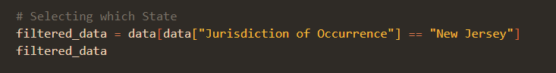
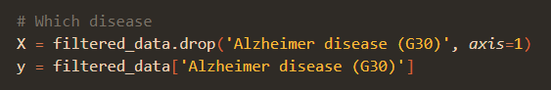
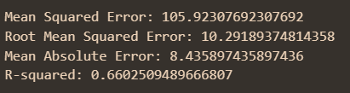
Explaining the Results (pt. 2)
Selecting the State
Selecting the Disease
MSE
RMSE
MAE
R-Squared

Slide 14
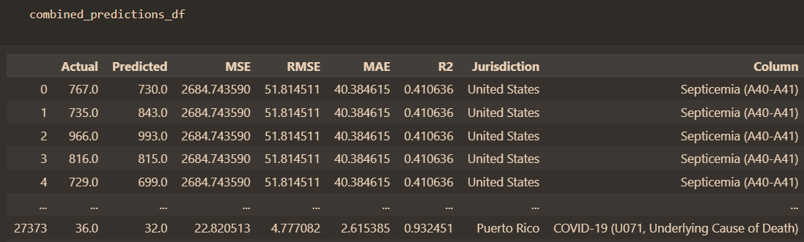
Results before Organizing

Slide 15
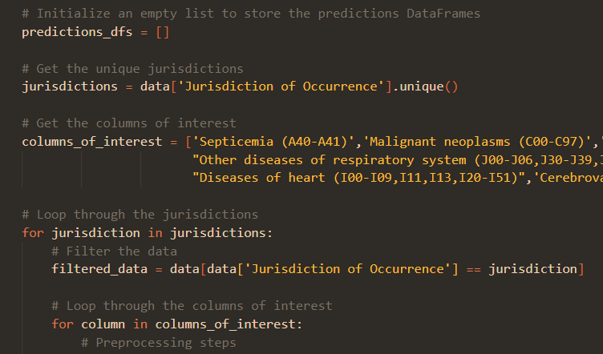
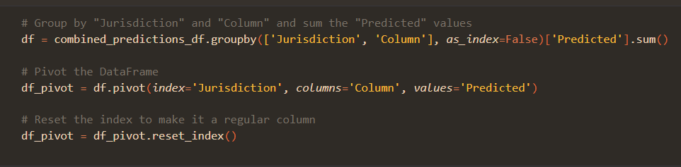
Organizing the Data
For Loop
Looped through all-states.
Looped through all diseases.
Groupby / Pivot
Grouped the states and diseases
Summed the predictions.

Slide 16

Decoding Death A Tableau Viz…

Slide 17
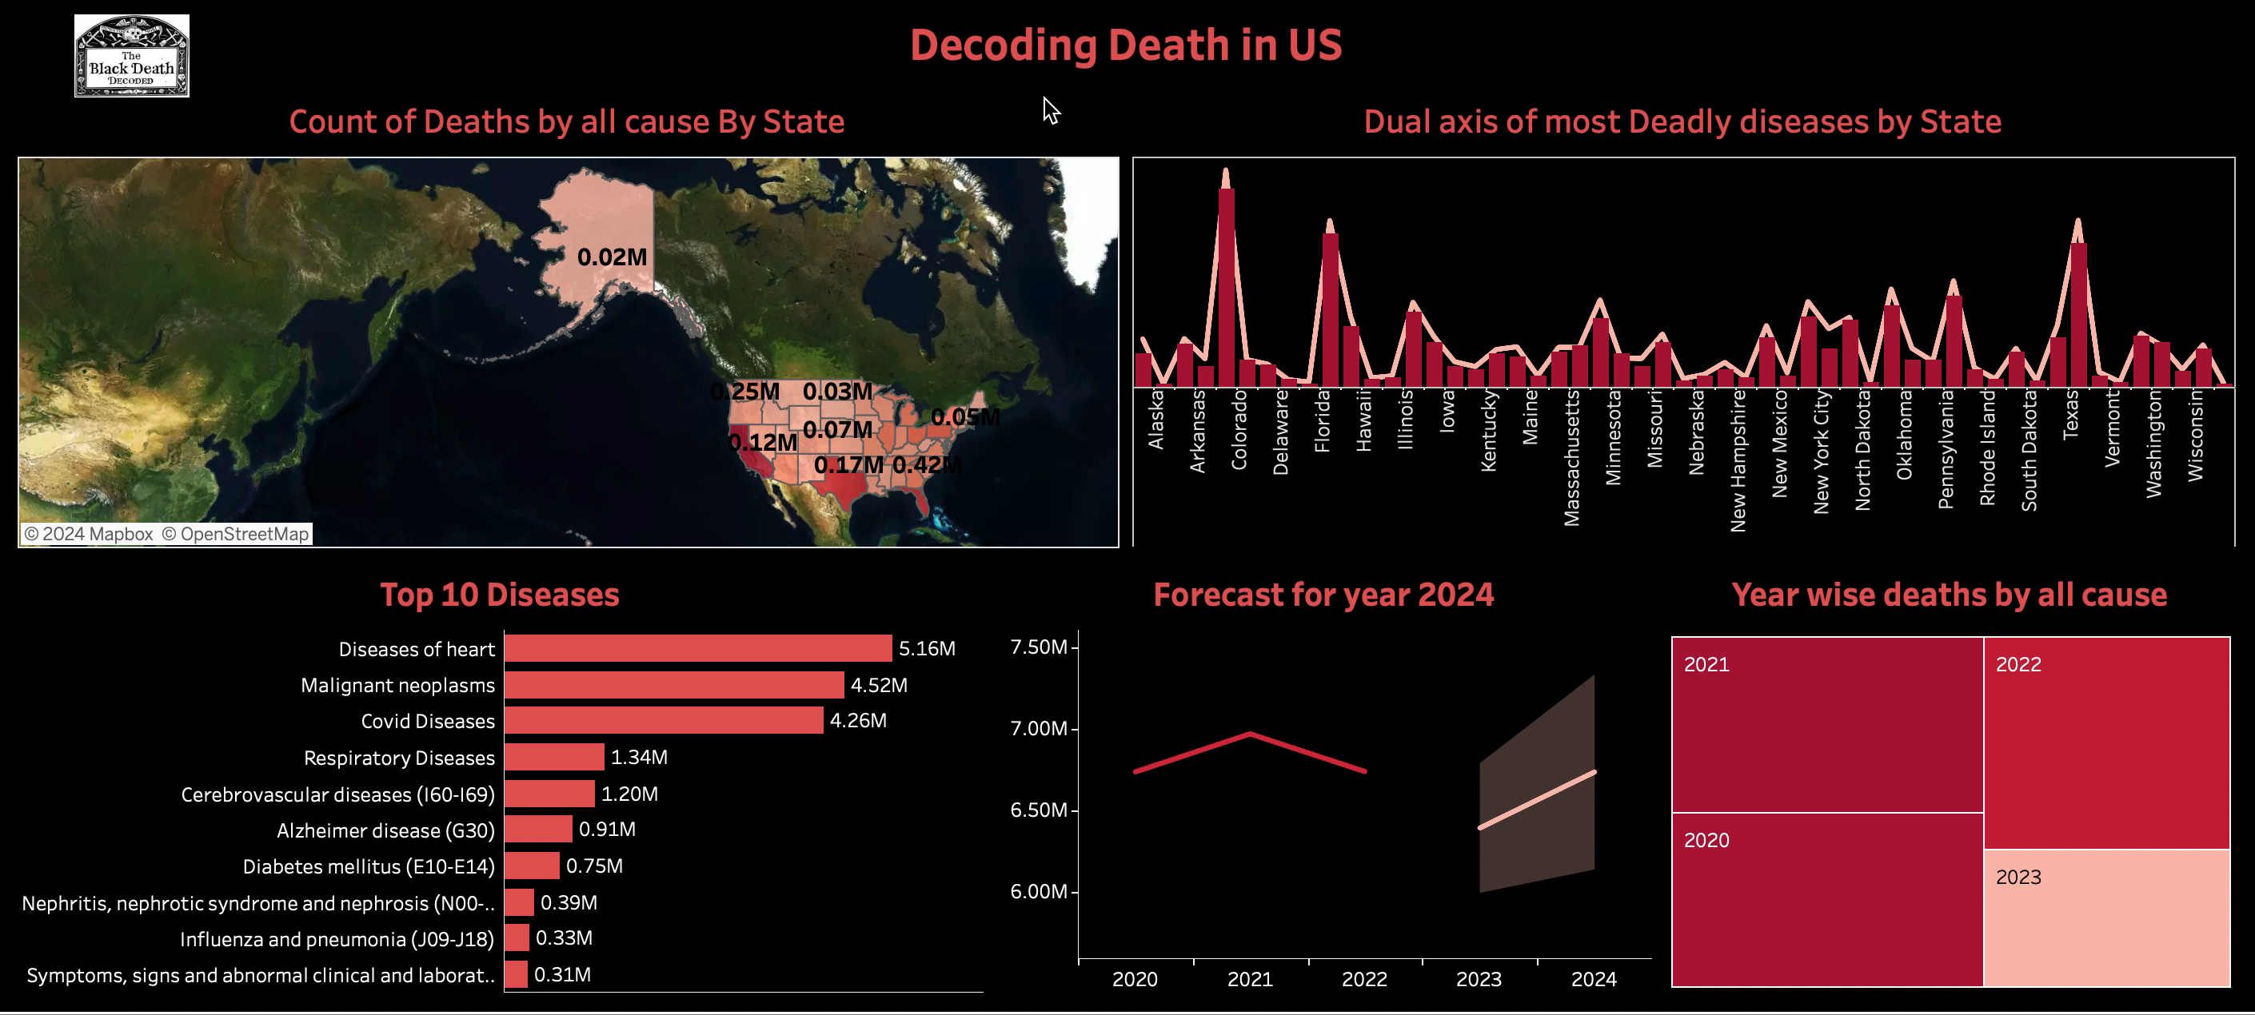

Slide 18
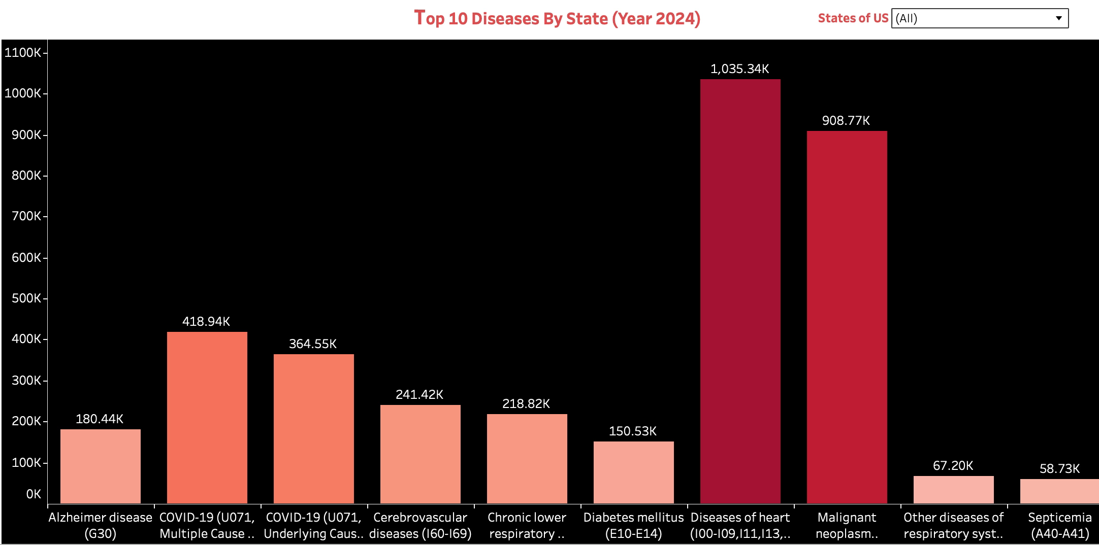

Slide 19

Summary
Machine Learning – Trying to DECODE(Predict) Death.
CDC Data
Data Cleaning
Modeling
Training Model(Prediction)
Goal of R-Squared > .80
Tableau
Notes:
Got our data from the CDC
We cleaned the data
Modeled it
Trained the model and our prediction model got a r-squared of .96
Took the data and displayed our results using Tableau

Slide 20
Summary - Implications
Implications for Public Health Policy
Discussion Points:
Resource Allocation
Preventive Strategies
Interstate Collaboration
Notes:
Healthcare policy does not cross state lines. Each state has their own policies.
By analyzing state-by-state mortality data, policymakers and public health officials can identify regions most in need of healthcare resources. This targeted approach allows for more efficient use of funds and manpower, focusing efforts where they are most needed to save lives.
The dashboard highlights diseases with the highest mortality rates, providing a basis for developing targeted preventive measures. By understanding these patterns, health departments can implement specific health programs, screenings, and education campaigns to prevent these conditions.
Health challenges do not respect state boundaries. This data encourages states to share insights and successful strategies for combating common diseases. Collaborative efforts can lead to innovations in treatment and prevention, benefiting a wider population.

Slide 21
Summary – Call to Action
Trends
Exploration
Follow-Up
Notes:
Today, we’ve looked trends in mortality across the United States, identifying key diseases and forecasting future trends. Our dashboard serves to understanding and reacting to these patterns.
So, our call to action is for People in the healthcare industry who are involved in planning and policy-making to use this data to better health outcomes.

Slide 22
QUESTIONS?

